Slide 1
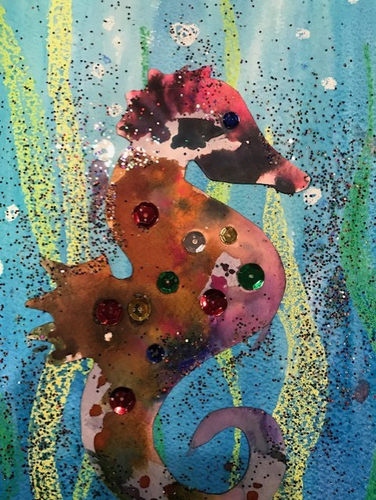
Watercolor Seahorse
Elements:
Value and Space
Artist:
Erik Carle

Slide 2
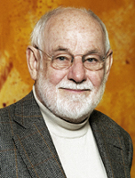
Erik Carle
The Very Hungry Caterpillar is Erik Carl’s most well know books that he wrote and illustrated. This book has been translated into 65 languages.
Erik Carl was born in 1929. that make him 90 years old. He was born in New York City but moved to Germany when he was 6 and finished school. It was always a dream of his to get back to America so when her was 23 he moved back to NYC with just $45 in his pocket and a portfolio of his work and landed a job at the New York Times as a graphic artist. He got his start in children’s book when he collaborated with Bill Martin Jr. on the book Brown bear Brown bear what do you see.

Slide 3
Elements
Value: Refers to the lightness or darkness of a color. Today we will be painting an under water scene. At the bottom of our paper (the deepest part of the water) the paint will be a darker blue. As we paint towards the top of the page we will use lighter and lighter blue. To do this we will do two things. Use less Blue paint and we will add more water to make it lighter..
Space: can mean a lot of things but today we are going to be using background and foreground. Our seahorse under water will have the water, bubbles, and plants as the background.. Our seahorse with be the subject and will be in the foreground which is upfront where people will be able to really notice it. It will be the most important part.

Slide 4
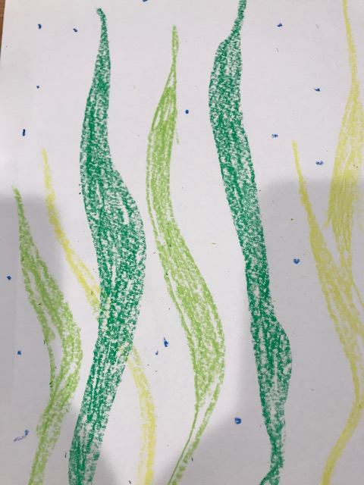
Step 1
Using your Green color Crayons draw 3-6 strands of tall grass. Starting at the bottom and drawing the at different heights with some reaching all the way to the top
Using your white and blue Crayons draw small bubbles all over the page. You will be able to see the blue crayon but the white will not show up until you add your paint.
Notes:
Keep them moving along at this. Don’t let them take too long…

Slide 5
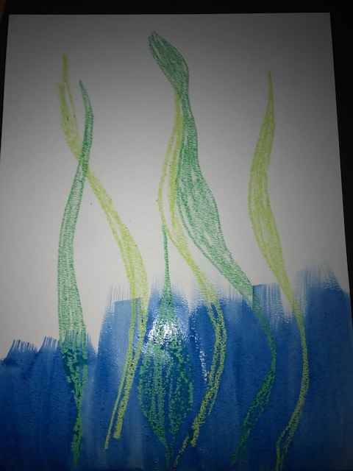
Step 2
Start adding the darkest Blue paint to the bottom of your page.. Use the big brush get lots of paint on your brush. Start at the bottom of the paper stopping about half way up

Slide 6
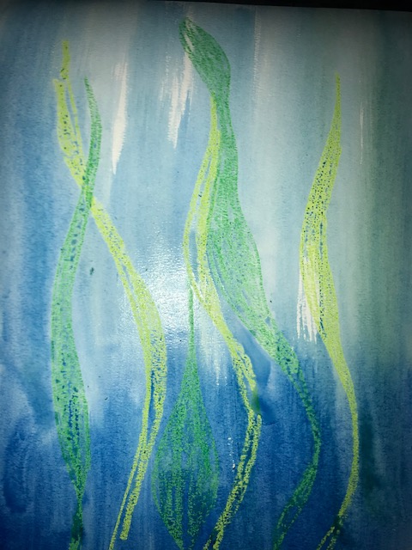
Step 3
Next, just get your brush really wet and start painting over the dark blue with water to drag the blue to the top. You will see it get lighter. You may add a bit of paint to your brush if you need to . Keep using a wet brush to drag light color to the top all the way across your page
Notes:
Docents, show the kids how to do this in person. I would show them in the class and again out in the pod as she get to that point.

Slide 7
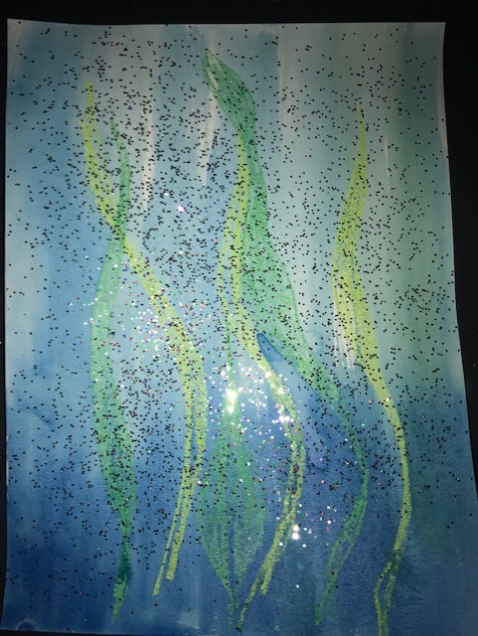
Step 4
Add a bit of glitter if you like
Set your background to the side to dry

Slide 8
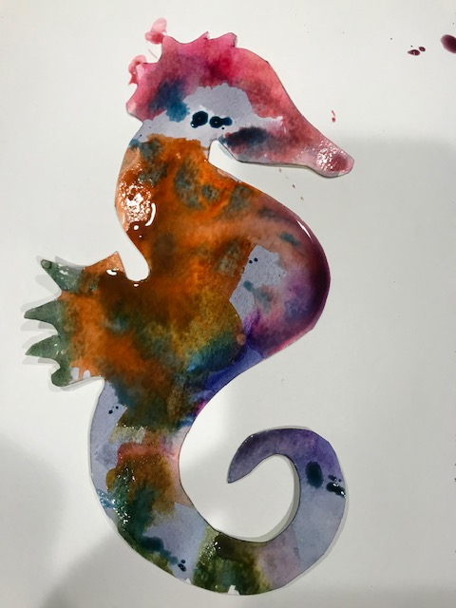
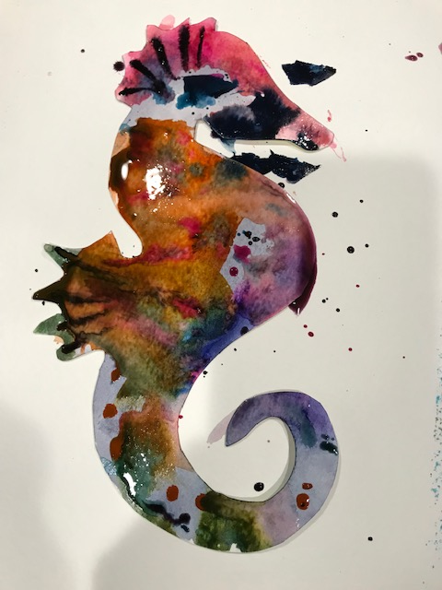
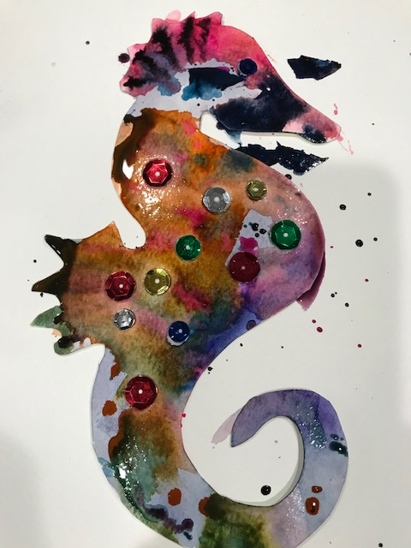
Step 5
Paint your Seahorse with many colors.
Try not to let all your colors mix together
Add details to your seahorse like dots and lines with the smaller brush
Add sequence with glue to your seahorse

Slide 9
Step 6
Place you seahorse and your background
on the drying rack.

Slide 10
Docent Instructions
Materials needed:
Watercolor paper
Precut seahorse cutout
Water color paints
Green blue and white crayons
Large paint brushes
Fine paint brushes
Water cups
White glue
Paper plate for glue
Sequence
Glitter
Mister seahorse book by Erik Carle
Suggested Prep work:
Cover tables with paper.
Put out crayons and paper
Make sure they put their name on back of paper first
In center of table put water and brushes
Have a few share plates of glue up at sink counter for later.
Keep glitter separate and monitored by an adult
Hand out seahorse as needed..
Collect crayons as they finish
Hand out glue and sequence as needed
Crayon portion can be done in classroom. Then move out
to pod to paint
Do not glue the seahorse down until totally dry. I suggest overnight. Then take all home or to workroom, glue down then stack and apply weight to remove warping from water.

